Slide 1

AICHI BIODIVERSITY TARGETS AND SUSTAINABLE DEVELOPMENTAL GOALS
GROUP 14
GROUP 14

Slide 2
PRESENTATION OUTLINE
INTRODUCTION TO AICHI BIODIVERSITY TARGETS
THE IMPORTANCE OF AICHI BIODIVERSITY TARGETS
THE 20 AICHI BIODIVERSITY TARGETS
CHALLENGES FACED IN ACHIEVING THE TARGETS
OVERVIEW OF SUSTAINABLE DEVELOPMENTAL GOALS
THE 17 SUSTAINABLE DEVELOPMENTAL GOALS
CONCLUSION

Slide 3
INTRODUCTION TO AICHI BIODIVERSITY TARGETS
The Aichi biodiversity targets were established by the UN Convention of Biological Diversity and consist of 20 specific targets to address and mitigate biodiversity loss across the globe.
They were set by 196 countries at Nagoya, Japan in 2011.
They remain one of the most diverse and adaptable management and institutional tools for achieving conservation.

Slide 4


AICHI BIODIVERSITY TARGETS:STRATEGIC GOAL A
  Addressing the underlying causes of biodiversity loss by mainstreaming across government and society.
Created awareness.
Integrated the values of biodiversity into national and local development.

Slide 5


AICHI BIODIVERSITY TARGETS:STRATEGIC GOAL A
Eliminated incentives harmful to biodiversity.
Implemented plans for sustainable production and consumption of natural resources.

Slide 6



AICHI BIODIVERSITY TARGETS: STRATEGIC GOAL B
  Reduce the direct pressures on biodiversity and promote its sustainable use.
Checked the rate of natural habitat loss.
Sustainably managed and harvested aquatic organisms
Managed areas under agriculture, aquaculture and forestry.

Slide 7



AICHI BIODIVERSITY TARGETS: STRATEGIC GOAL B
Checked pollution and reduced its impact in the ecosystem
Eradicated invasive species
Impact of climate change or ocean acidification on coral reefs and other vulnerable ecosystems have been reduced.

Slide 8



AICHI BIODIVERSITY TARGETS: STRATEGIC GOAL C
  To improve the status of biodiversity by safeguarding ecosystems, species and genetic biodiversity.
Terrestrial and inland waters must have been conserved.
Conserved and sustained the extinction of known threatened species.
Maintained genetic diversity of cultivated plants and domesticated organisms.

Slide 9



AICHI BIODIVERSITY TARGETS: STRATEGIC GOAL D
  Enhance the benefits to all from biodiversity and ecosystem services
Restored and safeguarded ecosystems that provided ecological services.
Enhanced the increase in carbon stocks in the atmosphere.
By 2015, the Nagoya Protocol on Access to Genetic Resources and the fair and equitable sharing of benefits arising from their Utilization is in force and operational.

Slide 10


AICHI BIODIVERSITY TARGETS: STRATEGIC GOAL E
  Enhance implementation through participating planning, knowledge management and capacity building.
By 2015 each Party has developed and commenced an updated national biodiversity plan.
Traditional knowledge that are relevant to conservation of biodiversity are respected.

Slide 11


AICHI BIODIVERSITY TARGETS: STRATEGIC GOAL E
Knowledge of science and technology relevant to biodiversity are improved, transeferred and shared.
Mobilized financial resources for effectively implementing the Strategic Plan for Biodiversity 2011-2020 from all sources.

Slide 12
CHALLENGES FACED IN ACHIEVING THE TARGETS
Inadequate funding.
Insufficient public awareness and involvement.
Lack of political will.

Slide 13
SUSTAINABLE DEVELOPMENTAL GOALS
The Sustainable Development Goals (SDGs) were born at the United Nations Conference on Sustainable Development in Rio de Janeiro in 2012.
Adopted by 193 countries in 2015
The United Nations’ 17 SDGs are the world’s shared plan to:
  end extreme poverty
  reduce inequality
  protect the planet
  ensure decent lives by 2030

Slide 14










SUSTAINABLE DEVELOPMENTAL GOALS

Slide 15



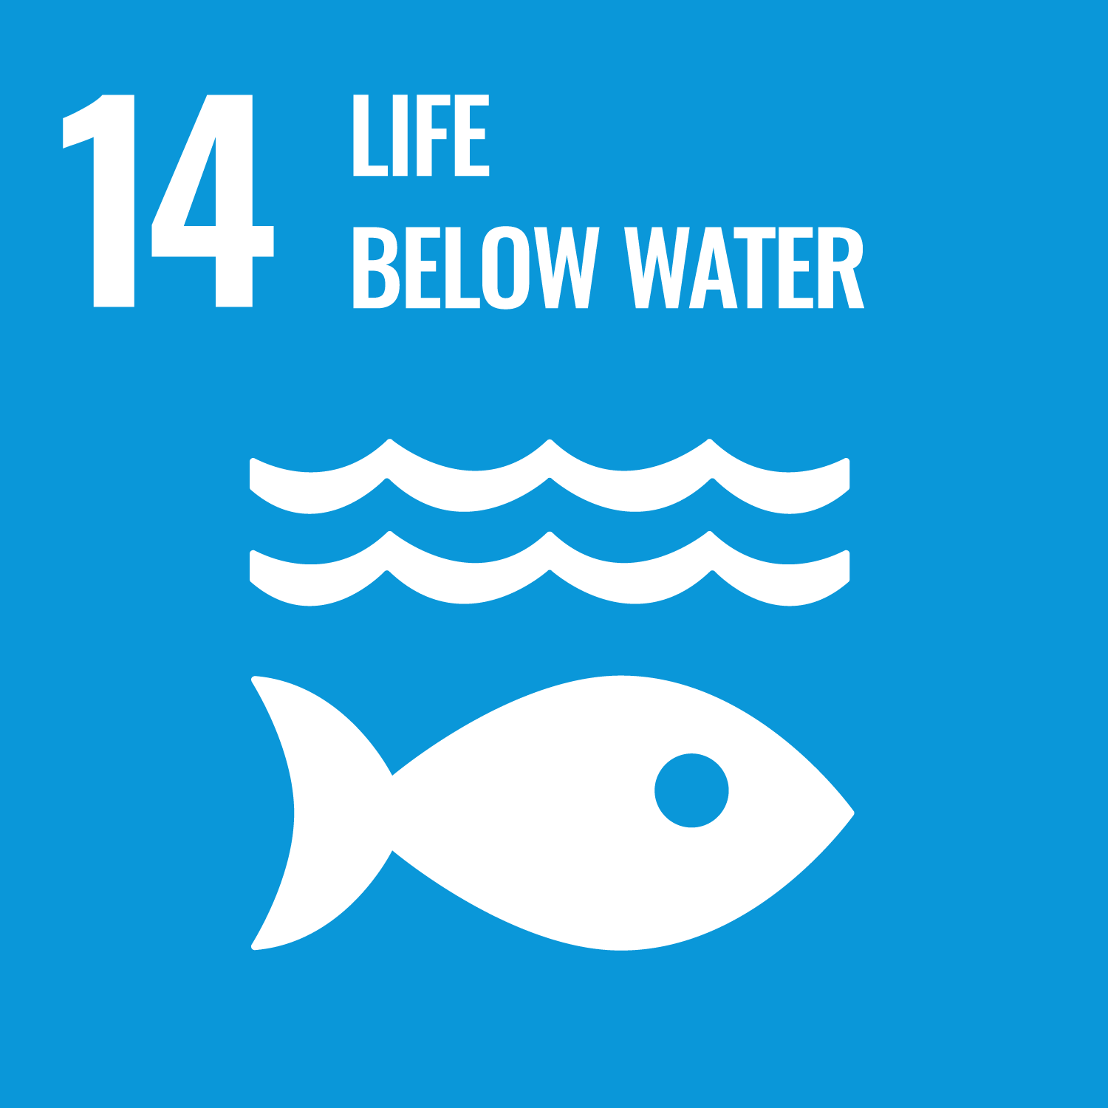
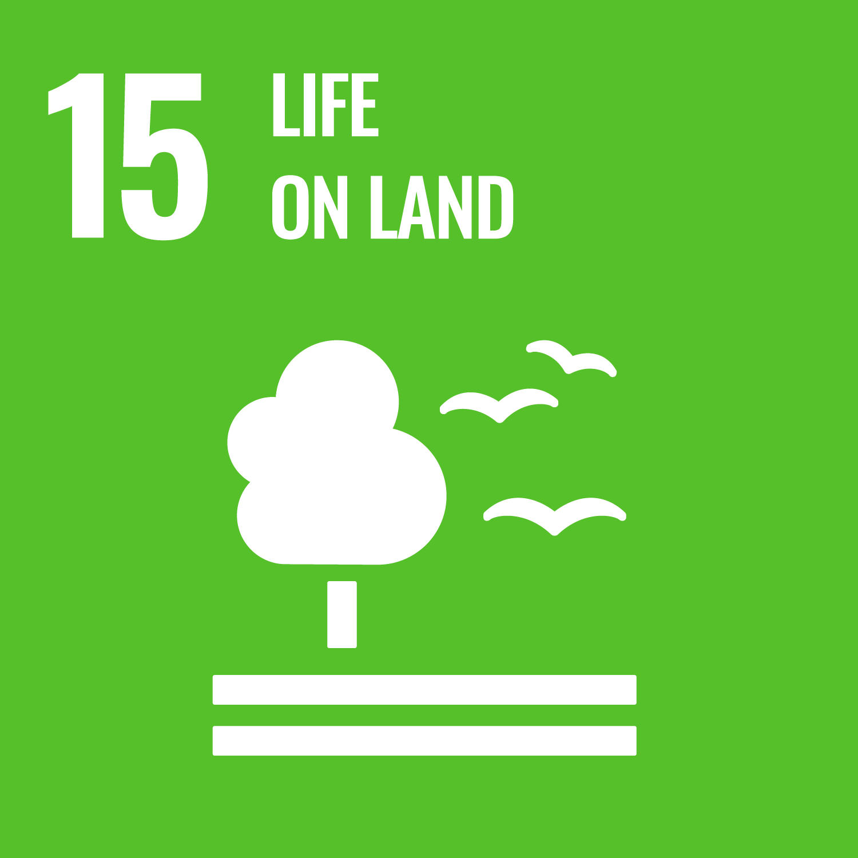


SUSTAINABLE DEVELOPMENTAL GOALS

Slide 16
CONCLUSION
The conservation of biodiversity is a critical and urgent challenge that demands immediate action from all levels of society. Let us all take inspiration from fighting for a better planet to making a positive impact.

Slide 17
REFERENCES
Lai, O. (2022). What are the Aichi biodiversity targets? Earth.Org. https://earth.org/what-are-the-aichi-biodiversity-targets/#:~:text=The%20Aichi%20biodiversity%20targets%20were,biodiversity%20loss%20across%20the%20globe.
Sightsavers (2022). What are the Sustainable Development Goals? Sustainable Developmental Goals. https://www.sightsavers.org/policy-and-advocacy/global-goals/?gad=1&gclid=Cj0KCQjwn_OlBhDhARIsAG2y6zNMf1CrVduOqhA4ENX_I99jZ5p6ojdQR8xrXc677zgIeXmX53rF3zkaAtxTEALw_wcB
United Nations Foundation (2017). Sustainable Developmental Goals. https://unfoundation.org/what-we-do/issues/sustainable-development-goals/?gclid=Cj0KCQjwn_OlBhDhARIsAG2y6zOQCn5XkjEDKg4dTx3F0EQFHpdF6iq1Uh5z5Ksb9OXlP98ZkKtbKvMaAkDKEALw_wcB
Convention on Biological Diversity (2011). Aichi Targets. https://www.cbd.int/aichi-targets/target/20

